Slide 1


Assembly Language for x86 Processors 7th Edition
Kip Irvine
Lecture 3: Assembly Language Fundamentals
(c) Pearson Education, 2015. All rights reserved. You may modify and copy this slide show for your personal use, or for use in the classroom, as long as this copyright statement, the author's name, and the title are not changed.
Last update: 27/04/2020

Slide 2
Lecture Overview
Background (Refer to Practical Malware Analysis book chapter 4 page 98)
Basic Elements of Assembly Language
Defining Data
Symbolic Constants
Irvine, Kip R. Assembly Language for x86 Processors 7/e, 2015.

Slide 3
Background – What is Assembly Lang?
Machine language executes on a computer architecture
Assembly language is a representation of a machine language
Obtained from disassembly of binary code
REM Lecture 2

Slide 4
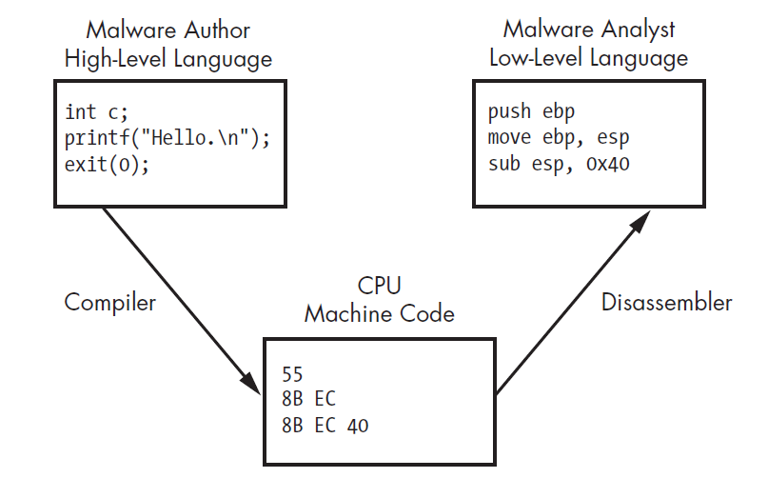
Background – Levels of Abstraction
IDA Pro
REM Lecture 2

Slide 5
Background – Why learn Assembly Lang?
Malware can be found in PE files
Basic static or dynamic malware analysis may be used for initial triage (e.g. malware family)
Analyzing malware code in assembly lang provides more complete info.
REM Lecture 2

Slide 6
x86 Architecture
Control unit gets instructions to execute from RAM using instruction pointer (IP)
IP – special register, stores address of next instruction to execute
Registers are CPU’s basic storage units (faster access than RAM)
Arithmetic Logic Unit (ALU) executes instructions from RAM, places results in registers / memory
REM Lecture 2

Slide 7
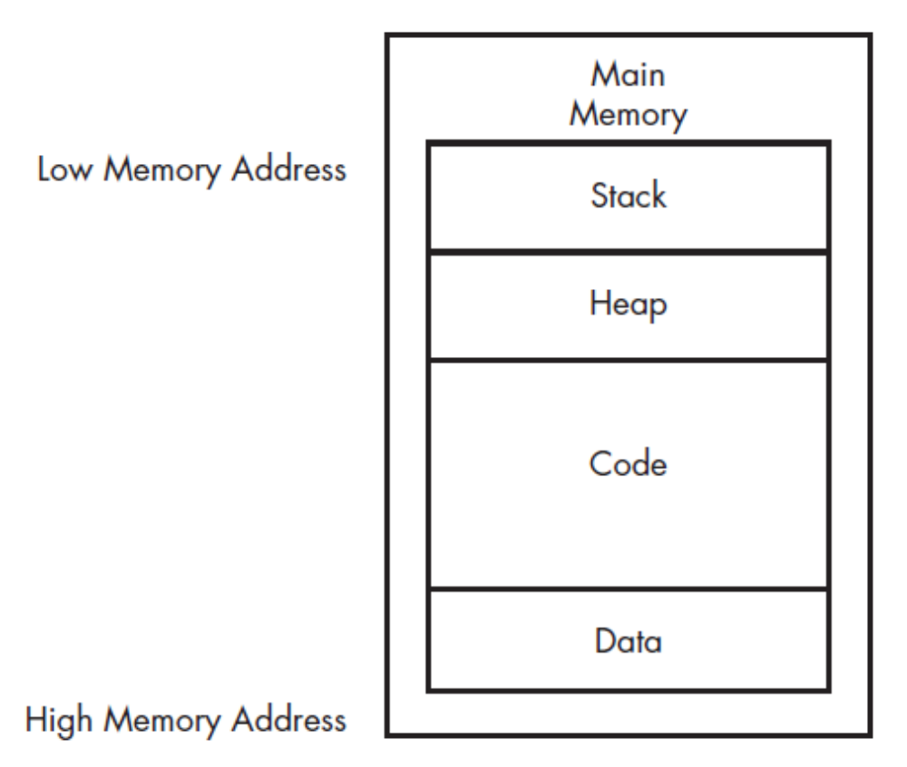
x86 Architecture - Main Memory
Order of different sections not fixed
REM Lecture 2

Slide 8
x86 Architecture - Main Memory
Data section contains values when program is initially loaded (static, global)
Code section contains program instructions to be executed
Heap section is used as dynamic memory to allocate new values and free unwanted values
Stack section is used for local variables and function parameters; also used to control program flow
REM Lecture 2

Slide 9
Basic Elements of Assembly Language
Integer constants
Integer expressions
Character and string constants
Reserved words and identifiers
Directives and instructions
Labels
Mnemonics and Operands
Comments
Examples
Irvine, Kip R. Assembly Language for x86 Processors 7/e, 2015.

Slide 10
Integer Constants
Optional leading + or – sign
binary, decimal, hexadecimal, or octal digits
Common radix characters:
  h – hexadecimal
  d – decimal
  b – binary
  r – encoded real
Examples: 30d, 6Ah, 42, 1101b
Hexadecimal beginning with letter: 0A5h
Irvine, Kip R. Assembly Language for x86 Processors 7/e, 2015.

Slide 11
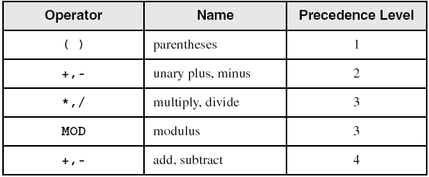
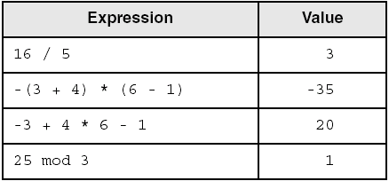
Integer Expressions
Operators and precedence levels:
Examples:
Irvine, Kip R. Assembly Language for x86 Processors 7/e, 2015.

Slide 12
Character and String Constants
Enclose character in single or double quotes
  'A', "x"
  ASCII character = 1 byte
Enclose strings in single or double quotes
  "ABC"
  'xyz'
  Each character occupies a single byte
Embedded quotes:
  'Say "Goodnight," Gracie'
Irvine, Kip R. Assembly Language for x86 Processors 7/e, 2015.

Slide 13
Reserved Words and Identifiers
Reserved words cannot be used as identifiers
  Instruction mnemonics, directives, type attributes, operators, predefined symbols
Identifiers
  1-247 characters, including digits
  not case sensitive
  first character must be a letter, _, @, ?, or $
Irvine, Kip R. Assembly Language for x86 Processors 7/e, 2015.

Slide 14
Directives
Commands that are recognized and acted upon by the assembler
  Not part of the Intel instruction set
  Used to declare code, data areas, select memory model, declare procedures, etc.
  not case sensitive
Different assemblers have different directives
Irvine, Kip R. Assembly Language for x86 Processors 7/e, 2015.

Slide 15
Instructions
Assembled into machine code by assembler
Executed at runtime by the CPU
We use the Intel IA-32 instruction set
An instruction contains:
  Label (optional)
  Mnemonic (required)
  Operand (depends on the instruction)
  Comment (optional)
Irvine, Kip R. Assembly Language for x86 Processors 7/e, 2015.

Slide 16
Labels
Act as place markers
  marks the address (offset) of code and data
Follow identifer rules
Data label
  must be unique
  example: myArray (not followed by colon)
Code label
  target of jump and loop instructions
  example: L1: (followed by colon)
Irvine, Kip R. Assembly Language for x86 Processors 7/e, 2015.

Slide 17
Mnemonics and Operands
Instruction Mnemonics
  memory aid
  examples: MOV, ADD, SUB, MUL, INC, DEC
Operands
  constant
  constant expression
  register
  memory (data label)
Constants and constant expressions are often called immediate values
Irvine, Kip R. Assembly Language for x86 Processors 7/e, 2015.

Slide 18
Comments
Comments are good!
  explain the program's purpose
  when it was written, and by whom
  revision information
  tricky coding techniques
  application-specific explanations
Single-line comments
  begin with semicolon (;)
Multi-line comments
  begin with COMMENT directive and a programmer-chosen character
  end with the same programmer-chosen character
Irvine, Kip R. Assembly Language for x86 Processors 7/e, 2015.

Slide 19
Instruction Format Examples
No operands
  stc ; set Carry flag
One operand
  inc eax ; register
  inc myByte ; memory
Two operands
  add ebx,ecx ; register, register
  sub myByte,25 ; memory, constant
  add eax,36 * 25 ; register, constant-expression
Irvine, Kip R. Assembly Language for x86 Processors 7/e, 2015.

Slide 20
Defining Data
Intrinsic Data Types
Data Definition Statement
Defining BYTE and SBYTE Data
Defining WORD and SWORD Data
Defining DWORD and SDWORD Data
Defining QWORD Data
Defining TBYTE Data
Defining Real Number Data
Little Endian Order
Adding Variables to the AddSub Program
Declaring Uninitialized Data
Irvine, Kip R. Assembly Language for x86 Processors 7/e, 2015.

Slide 21
Intrinsic Data Types (1 of 2)
BYTE, SBYTE
  8-bit unsigned integer; 8-bit signed integer
WORD, SWORD
  16-bit unsigned & signed integer
DWORD, SDWORD
  32-bit unsigned & signed integer
QWORD
  64-bit integer
TBYTE
  80-bit integer
Irvine, Kip R. Assembly Language for x86 Processors 7/e, 2015.

Slide 22
Intrinsic Data Types (2 of 2)
REAL4
  4-byte IEEE short real
REAL8
  8-byte IEEE long real
REAL10
  10-byte IEEE extended real
Irvine, Kip R. Assembly Language for x86 Processors 7/e, 2015.

Slide 23
Data Definition Statement
A data definition statement sets aside storage in memory for a variable.
May optionally assign a name (label) to the data
Syntax:
  [name] directive initializer [,initializer] . . .
  value1 BYTE 10
All initializers become binary data in memory
Irvine, Kip R. Assembly Language for x86 Processors 7/e, 2015.

Slide 24
Defining BYTE and SBYTE Data
Each of the following defines a single byte of storage:
value1 BYTE 'A' ; character constant
value2 BYTE 0 ; smallest unsigned byte
value3 BYTE 255 ; largest unsigned byte
value4 SBYTE -128 ; smallest signed byte
value5 SBYTE +127 ; largest signed byte
value6 BYTE ? ; uninitialized byte
MASM does not prevent you from initializing a BYTE with a negative value, but it's considered poor style.
If you declare a SBYTE variable, the Microsoft debugger will automatically display its value in decimal with a leading sign.
Irvine, Kip R. Assembly Language for x86 Processors 7/e, 2015.

Slide 25
Defining Byte Arrays
Examples that use multiple initializers:
list1 BYTE 10,20,30,40
list2 BYTE 10,20,30,40
BYTE 50,60,70,80
BYTE 81,82,83,84
list3 BYTE ?,32,41h,00100010b
list4 BYTE 0Ah,20h,‘A’,22h
Irvine, Kip R. Assembly Language for x86 Processors 7/e, 2015.

Slide 26
Defining Strings (1 of 3)
A string is implemented as an array of characters
  For convenience, it is usually enclosed in quotation marks
  It often will be null-terminated
Examples:
str1 BYTE "Enter your name",0
str2 BYTE 'Error: halting program',0
str3 BYTE 'A','E','I','O','U'
greeting BYTE "Welcome to the Encryption Demo program "
BYTE "created by Kip Irvine.",0
Irvine, Kip R. Assembly Language for x86 Processors 7/e, 2015.

Slide 27
Defining Strings (2 of 3)
To continue a single string across multiple lines, end each line with a comma:
menu BYTE "Checking Account",0dh,0ah,0dh,0ah,
"1. Create a new account",0dh,0ah,
"2. Open an existing account",0dh,0ah,
"3. Credit the account",0dh,0ah,
"4. Debit the account",0dh,0ah,
"5. Exit",0ah,0ah,
"Choice> ",0
Irvine, Kip R. Assembly Language for x86 Processors 7/e, 2015.

Slide 28
Defining Strings (3 of 3)
End-of-line character sequence:
  0Dh = carriage return
  0Ah = line feed
str1 BYTE "Enter your name: ",0Dh,0Ah
BYTE "Enter your address: ",0
newLine BYTE 0Dh,0Ah,0
Idea: Define all strings used by your program in the same area of the data segment.
Irvine, Kip R. Assembly Language for x86 Processors 7/e, 2015.

Slide 29
Using the DUP Operator
Use DUP to allocate (create space for) an array or string. Syntax: counter DUP ( argument )
Counter and argument must be constants or constant expressions
var1 BYTE 20 DUP(0) ; 20 bytes, all equal to zero
var2 BYTE 20 DUP(?) ; 20 bytes, uninitialized
var3 BYTE 4 DUP("STACK") ; 20 bytes: "STACKSTACKSTACKSTACK"
Irvine, Kip R. Assembly Language for x86 Processors 7/e, 2015.

Slide 30
Defining WORD and SWORD Data
Define storage for 16-bit integers
  or double characters
  single value or multiple values
word1 WORD 65535 ; largest unsigned value
word2 SWORD –32768 ; smallest signed value
word3 WORD ? ; uninitialized, unsigned
word4 WORD "AB" ; double characters
myList WORD 1,2,3,4,5 ; array of words
array WORD 5 DUP(?) ; uninitialized array
Irvine, Kip R. Assembly Language for x86 Processors 7/e, 2015.

Slide 31
Defining DWORD and SDWORD Data
Storage definitions for signed and unsigned 32-bit integers:
val1 DWORD 12345678h ; unsigned
val2 SDWORD –2147483648 ; signed
val3 DWORD 20 DUP(?) ; unsigned array
val4 SDWORD –3,–2,–1,0,1 ; signed array
Irvine, Kip R. Assembly Language for x86 Processors 7/e, 2015.

Slide 32
Defining QWORD, TBYTE, Real Data
Storage definitions for quadwords, tenbyte values, and real numbers:
quad1 QWORD 1234567812345678h
val1 TBYTE 1000000000123456789Ah
rVal1 REAL4 -2.1
rVal2 REAL8 3.2E-260
rVal3 REAL10 4.6E+4096
ShortArray REAL4 20 DUP(0.0)
Irvine, Kip R. Assembly Language for x86 Processors 7/e, 2015.

Slide 33
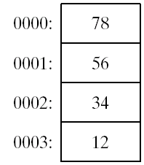
Little Endian Order
All data types larger than a byte store their individual bytes in reverse order. The least significant byte occurs at the first (lowest) memory address.
Example:
val1 DWORD 12345678h
Irvine, Kip R. Assembly Language for x86 Processors 7/e, 2015.

Slide 34
Adding Variables to AddSub
; This program adds and subtracts 32-bit unsigned
; integers and stores the sum in a variable.
.data
val1 DWORD 10000h
val2 DWORD 40000h
val3 DWORD 20000h
finalVal DWORD ?
.code
main PROC
mov eax,val1 ; start with 10000h
  add eax,val2 ; add 40000h
  sub eax,val3 ; subtract 20000h
  mov finalVal,eax ; store the result (30000h)
  call DumpRegs ; display the registers
  exit
main ENDP
END main
Irvine, Kip R. Assembly Language for x86 Processors 7/e, 2015.

Slide 35
Declaring Unitialized Data
Use the .data? directive to declare an unintialized data segment:
  .data?
Within the segment, declare variables with "?" initializers:
  smallArray DWORD 10 DUP(?)
Advantage: the program's EXE file size is reduced.
Irvine, Kip R. Assembly Language for x86 Processors 7/e, 2015.

Slide 36
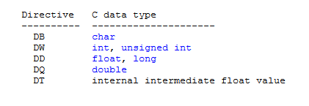
Data Allocation Directives – C Data Types
Correspondence to C data tyes
REM Lecture 2

Slide 37
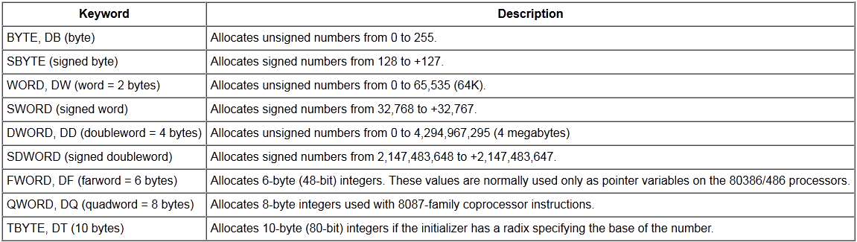
Data Allocation Directives – Reference
REM Lecture 2

Slide 38
Symbolic Constants
Equal-Sign Directive
Calculating the Sizes of Arrays and Strings
EQU Directive
TEXTEQU Directive
Irvine, Kip R. Assembly Language for x86 Processors 7/e, 2015.

Slide 39
Equal-Sign Directive
name = expression
  expression is a 32-bit integer (expression or constant)
  may be redefined
  name is called a symbolic constant
good programming style to use symbols
COUNT = 500
.
.
mov ax,COUNT
Irvine, Kip R. Assembly Language for x86 Processors 7/e, 2015.

Slide 40
EQU Directive
Define a symbol as either an integer or text expression.
Cannot be redefined
PI EQU <3.1416>
pressKey EQU <"Press any key to continue...",0>
.data
prompt BYTE pressKey
Irvine, Kip R. Assembly Language for x86 Processors 7/e, 2015.

Slide 41
TEXTEQU Directive
Define a symbol as either an integer or text expression.
Called a text macro
Can be redefined
continueMsg TEXTEQU <"Do you wish to continue (Y/N)?">
rowSize = 5
.data
prompt1 BYTE continueMsg
count TEXTEQU %(rowSize * 2) ; evaluates the expression
setupAL TEXTEQU <mov al,count>
.code
setupAL ; generates: "mov al,10"
Irvine, Kip R. Assembly Language for x86 Processors 7/e, 2015.

Slide 42
Summary
Integer expression, character constant
directive – interpreted by the assembler
instruction – executes at runtime
code, data, and stack segments
Data definition directives:
  BYTE, SBYTE, WORD, SWORD, DWORD, SDWORD, QWORD, TBYTE, REAL4, REAL8, and REAL10
  DUP operator, location counter ($)
Symbolic constant
  EQU and TEXTEQU
Irvine, Kip R. Assembly Language for x86 Processors 7/e, 2015.

Slide 43

4C 61 46 69 6E
Irvine, Kip R. Assembly Language for x86 Processors 7/e, 2015.

